Slide 1
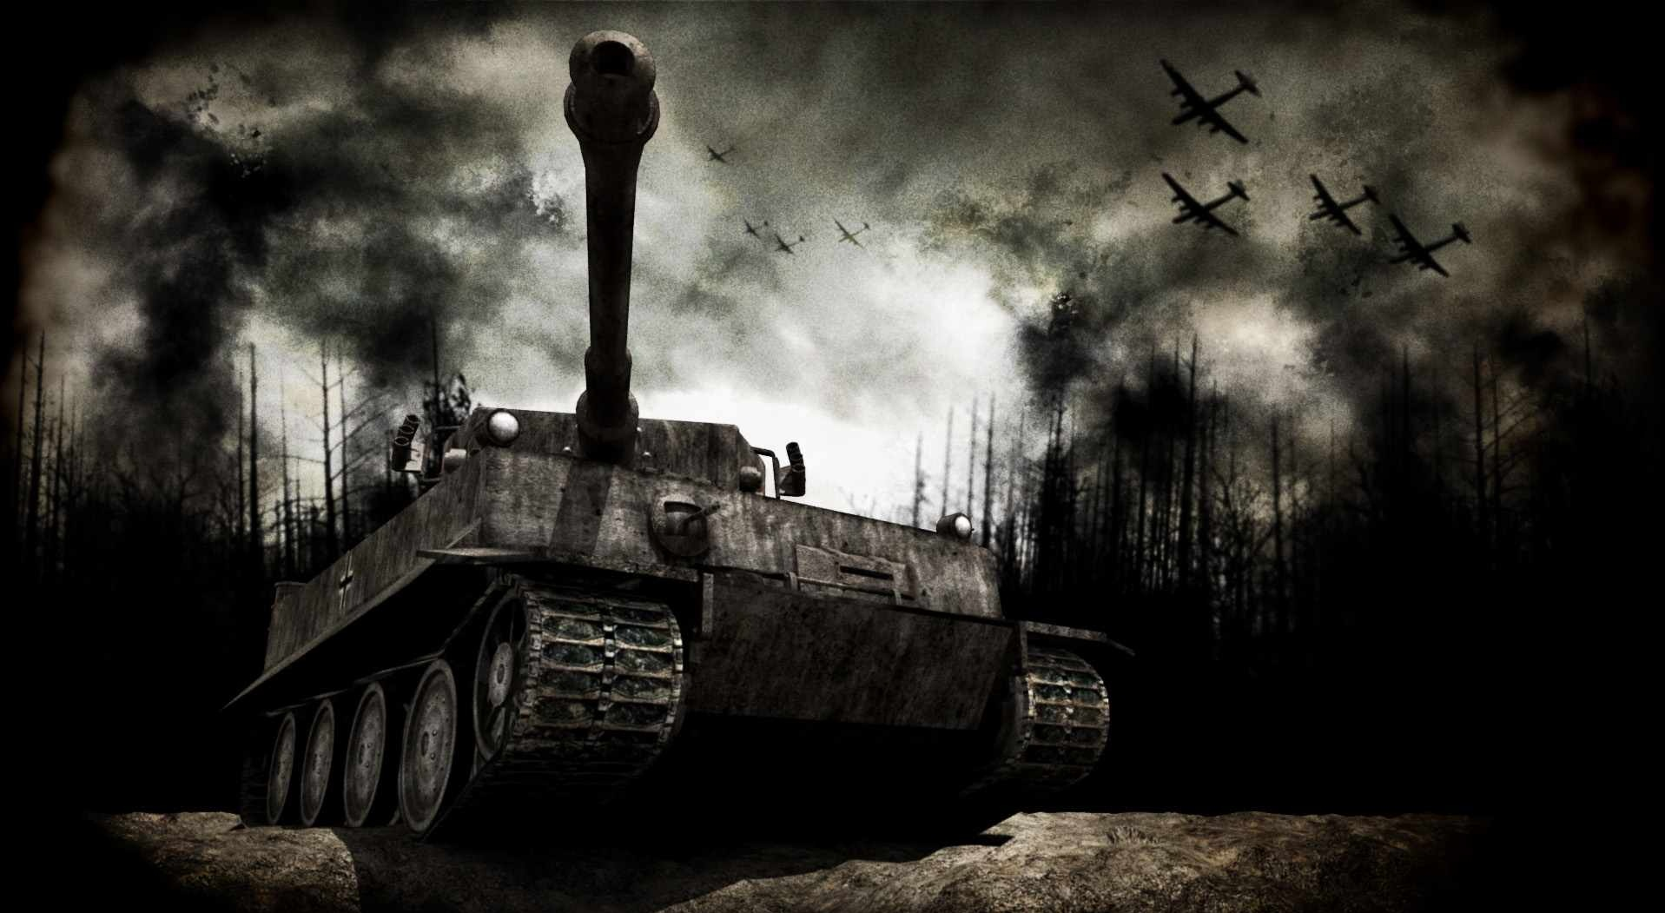
2
World War

Slide 2
MADE BY DINC
Daksh
Ishaan
Nimit
Chaitanya

Slide 3
INTRODUCTION
World War II (WWII or WW2), also known as the Second World War, was a global war that lasted from 1939 to 1945.
it
is a war affecting most of the world's most powerful and populous countries.

Slide 4
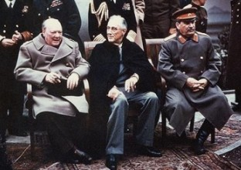
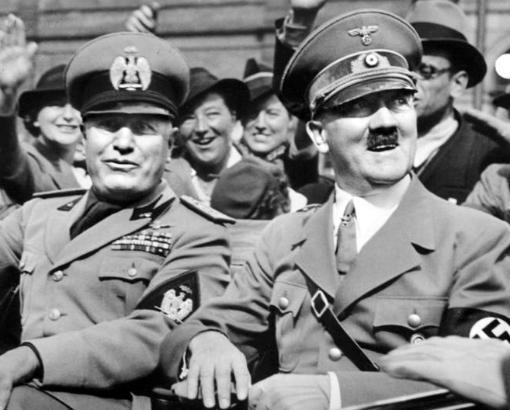
INTRODUCTION
It involved the vast majority of the world's nations—including all of the great powers—eventually forming two opposing military alliances: the Allies and the Axis.
France
Poland
United Kingdom
German
Italian
Japanese
Winston Churchill
Joseph Stalin
President Roosevelt
Duce Benito Mussolini
FührerAdolf Hitler

Slide 5
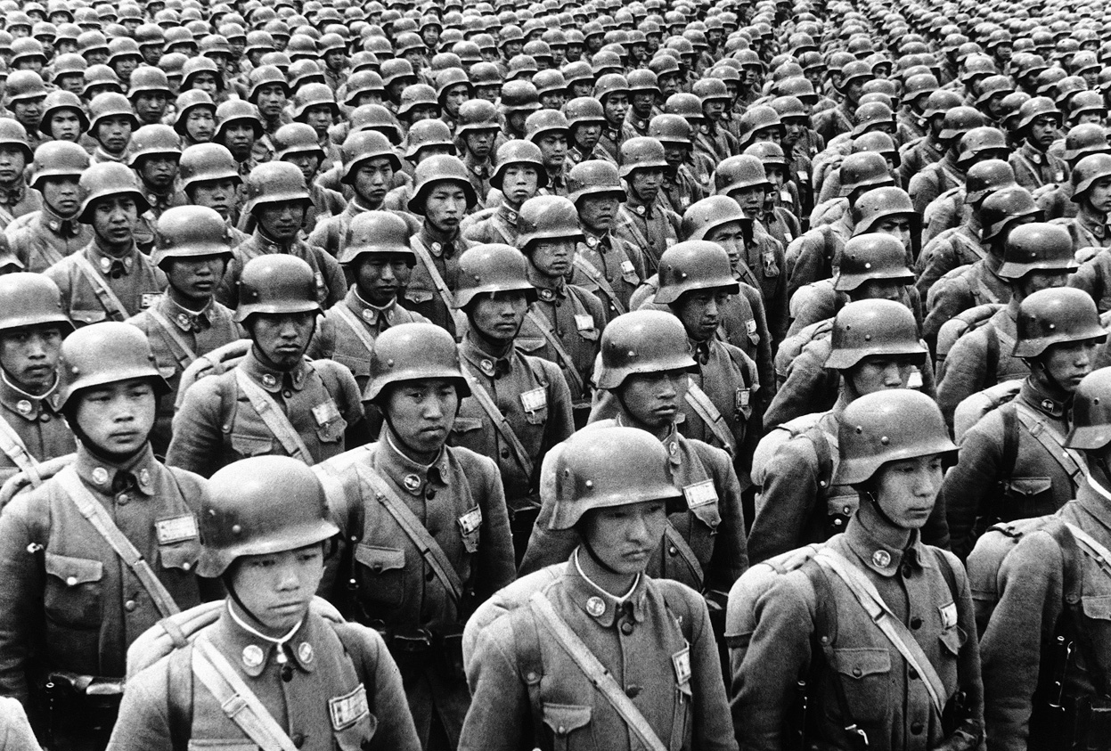
INTRODUCTION
It was the most widespread war in history, with more than 100 million people serving in military units from over 30 different countries. In a state of "total war"
Total war is a war in which a belligerent engages in the complete mobilization of fully available resources and population.

